Slide 1

Algorithmic Fairness of Statistical Decision Systems
Subhrajyoty Roy
14th August, 2021

Slide 2



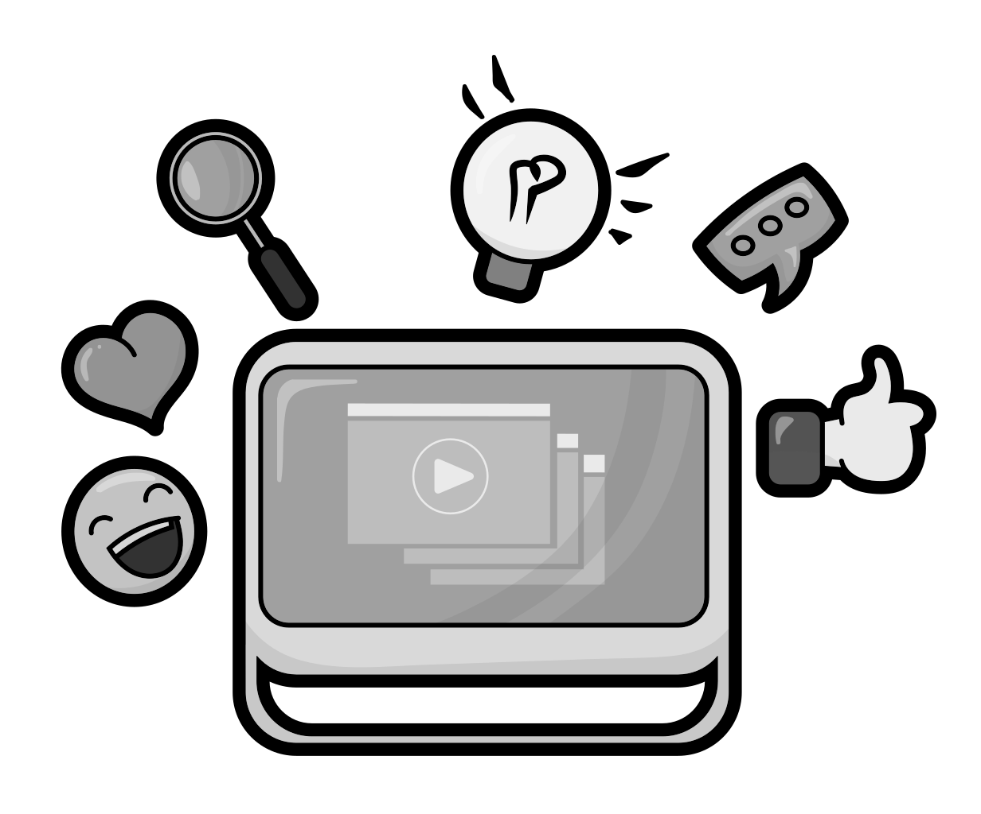

What Statistical Decision Systems offers?
Ideal
Avrio AI Inc.
Skillate
Entelo
Mya Systems
PredPol
COMPAS
many more confidential algorithms.
Recommendations
in e-commerce
Credit risk assessment in banks
Personalized news in social media

Slide 3


What Statistical Decision Systems offers?
Ideal
Avrio AI Inc.
Skillate
Entelo
Mya Systems
PredPol
COMPAS
many more confidential algorithms.
Recommendations
in e-commerce
Credit risk assessment in banks
Personalized news in social media

Slide 4

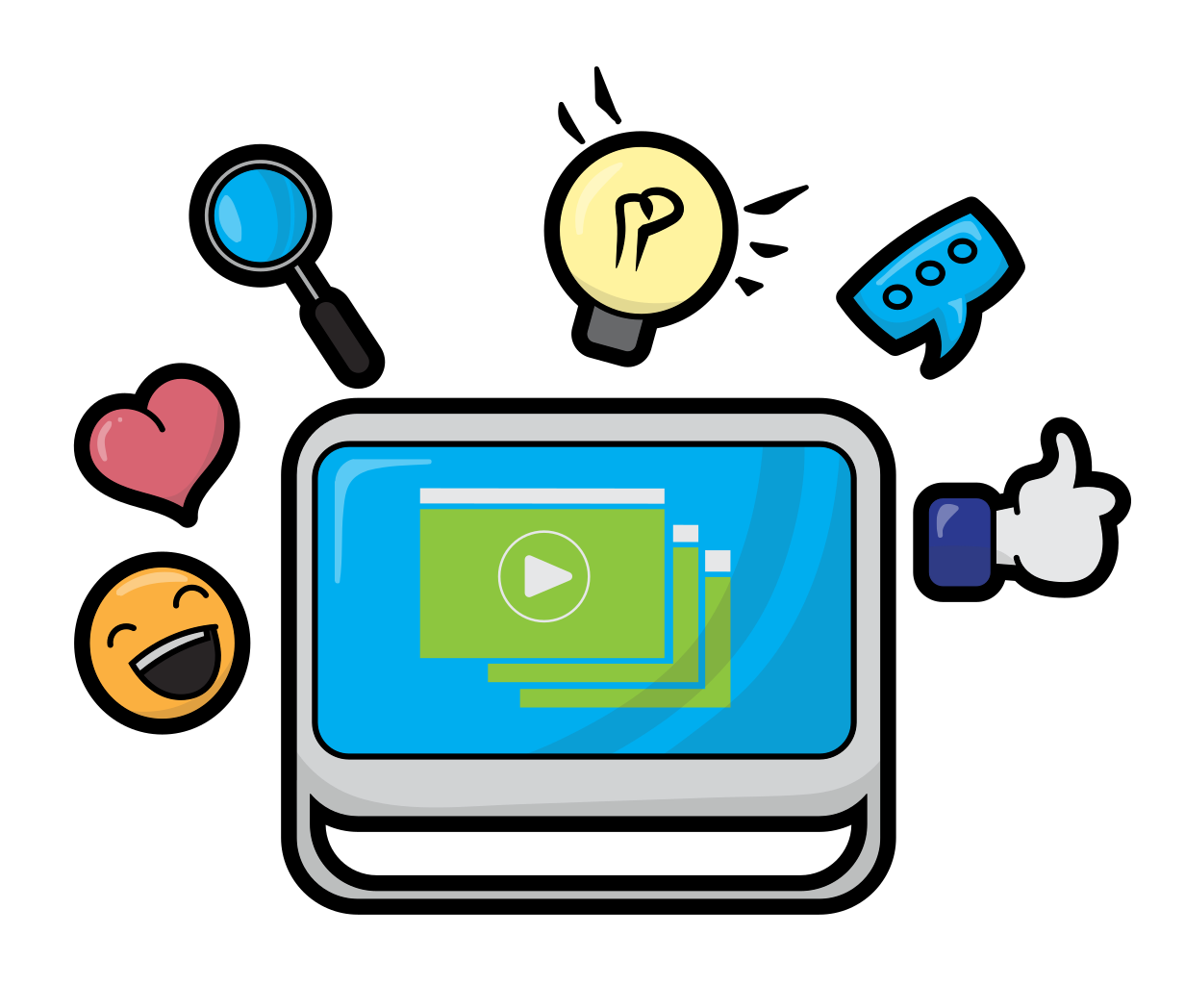

What Statistical Decision Systems offers?
Ideal
Avrio AI Inc.
Skillate
Entelo
Mya Systems
PredPol
COMPAS
many more confidential algorithms.
Recommendations
in e-commerce
Credit risk assessment in banks
Personalized news in social media

Slide 5
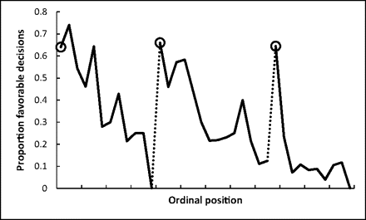
Why need Data-driven Automation?
Automated Judicial Systems
Hungry judges problem.
Automated Hiring and Resume Screening
One million applications per year to Google. That’s 2700+/day.
40 million active job searchers on LinkedIn.
35+ million graduates from bachelor courses every year in India according to MOE report.

Slide 6
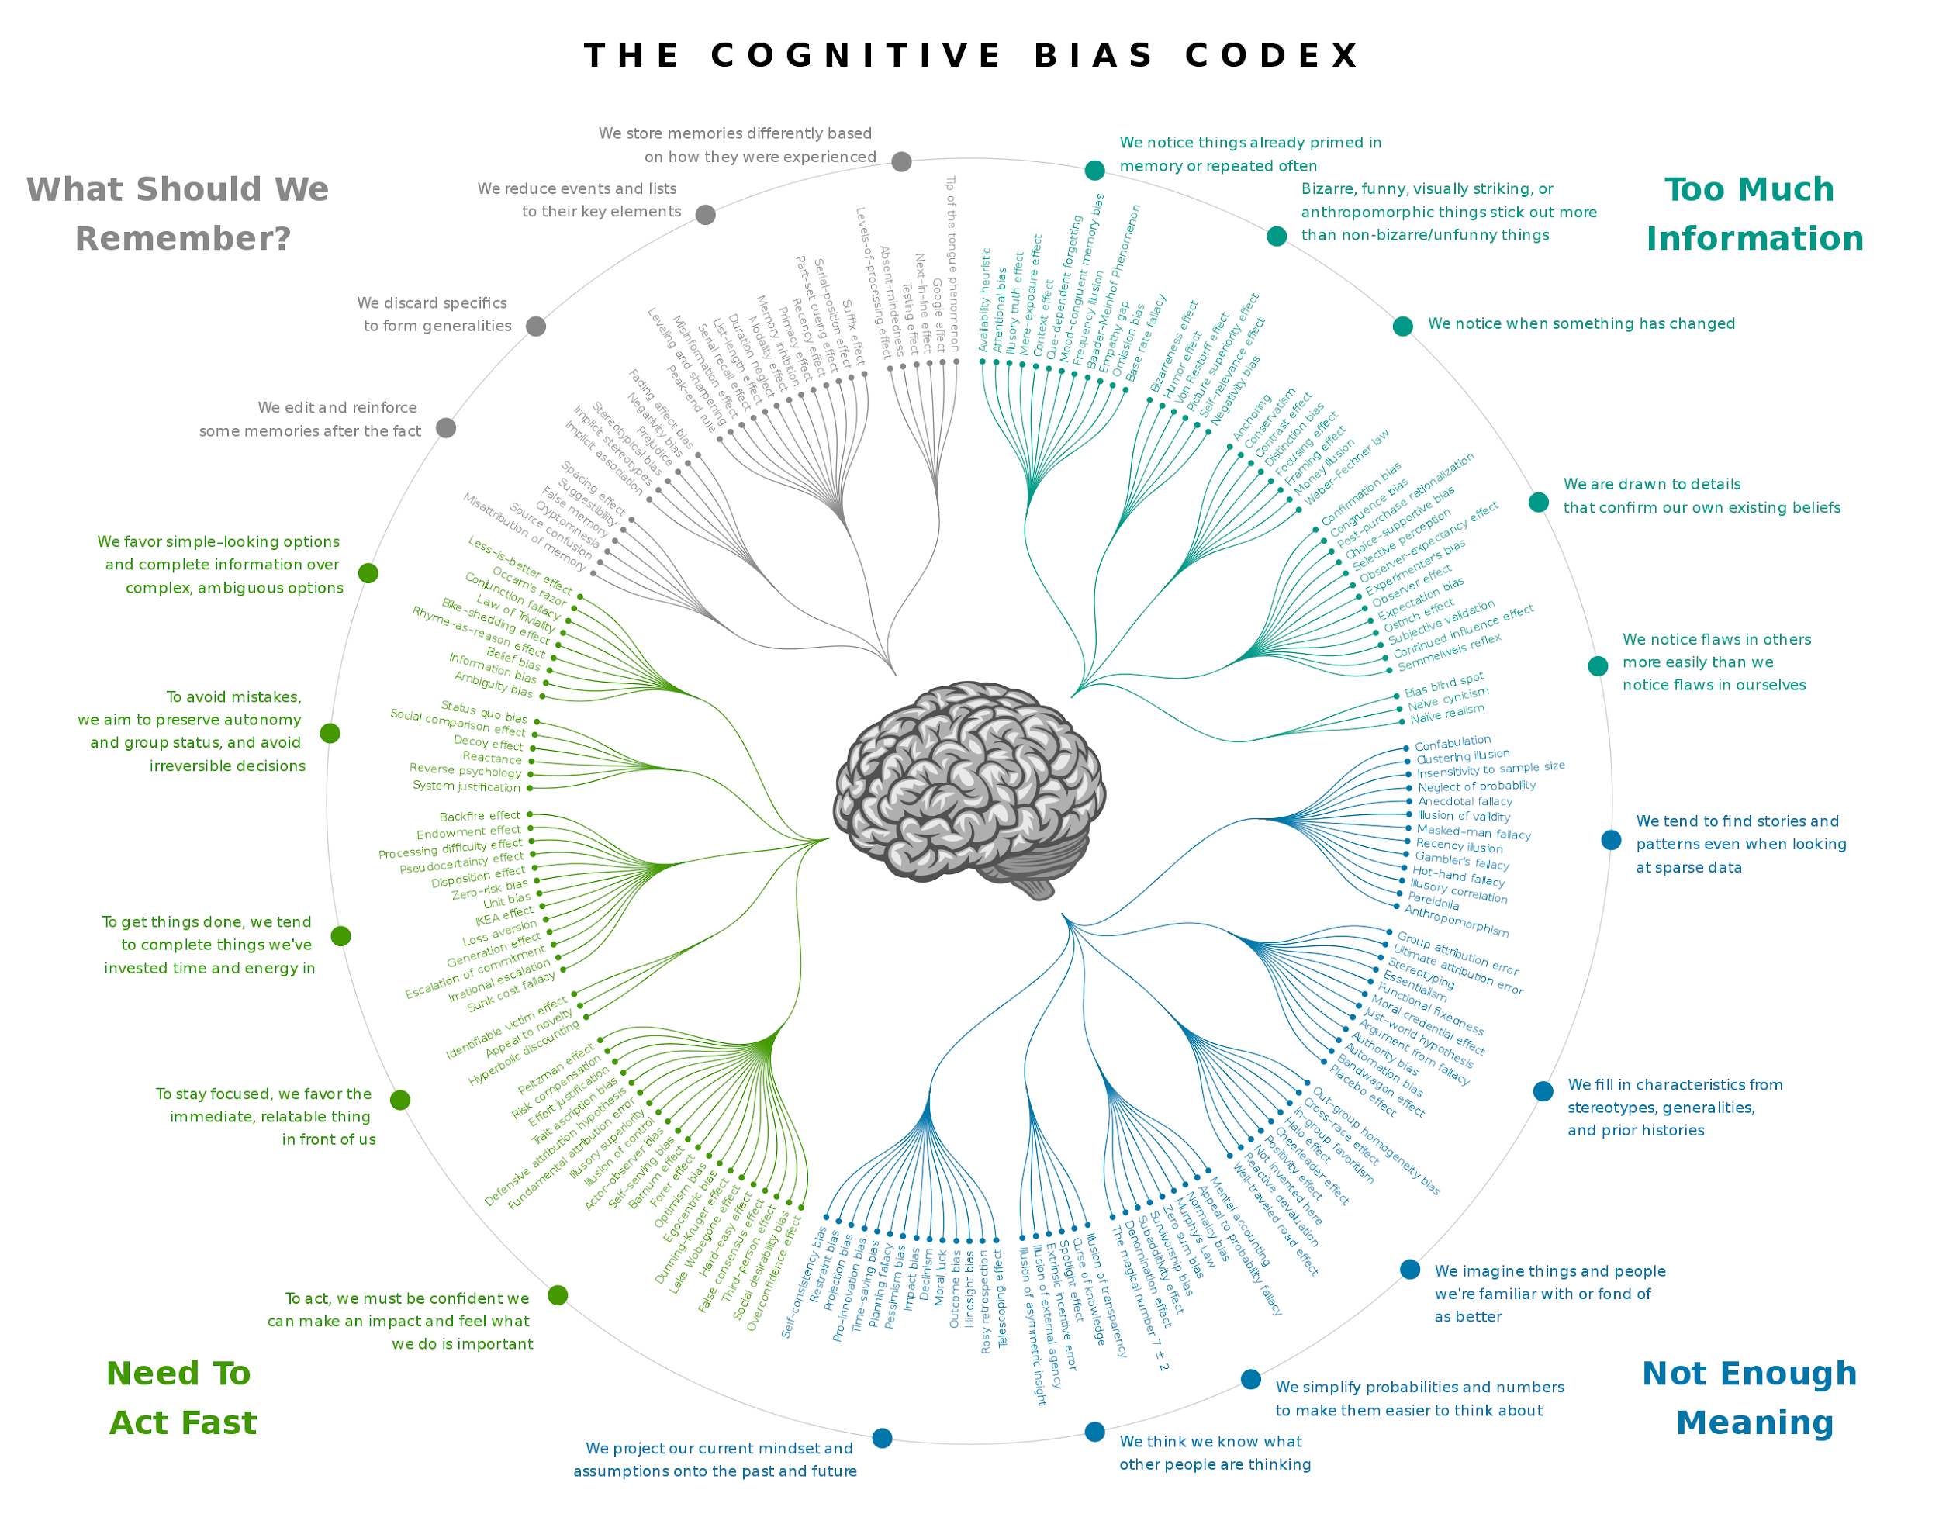
180+ Cognitive Biases of Human

Slide 7
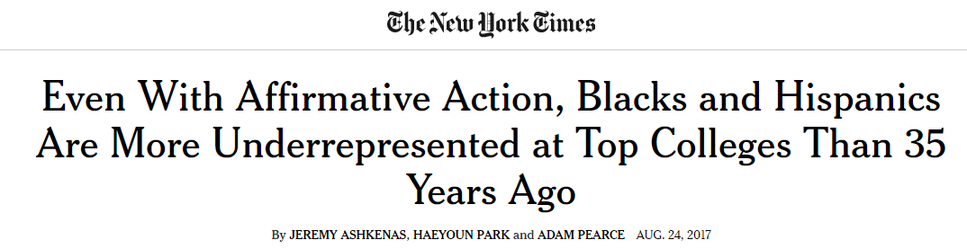
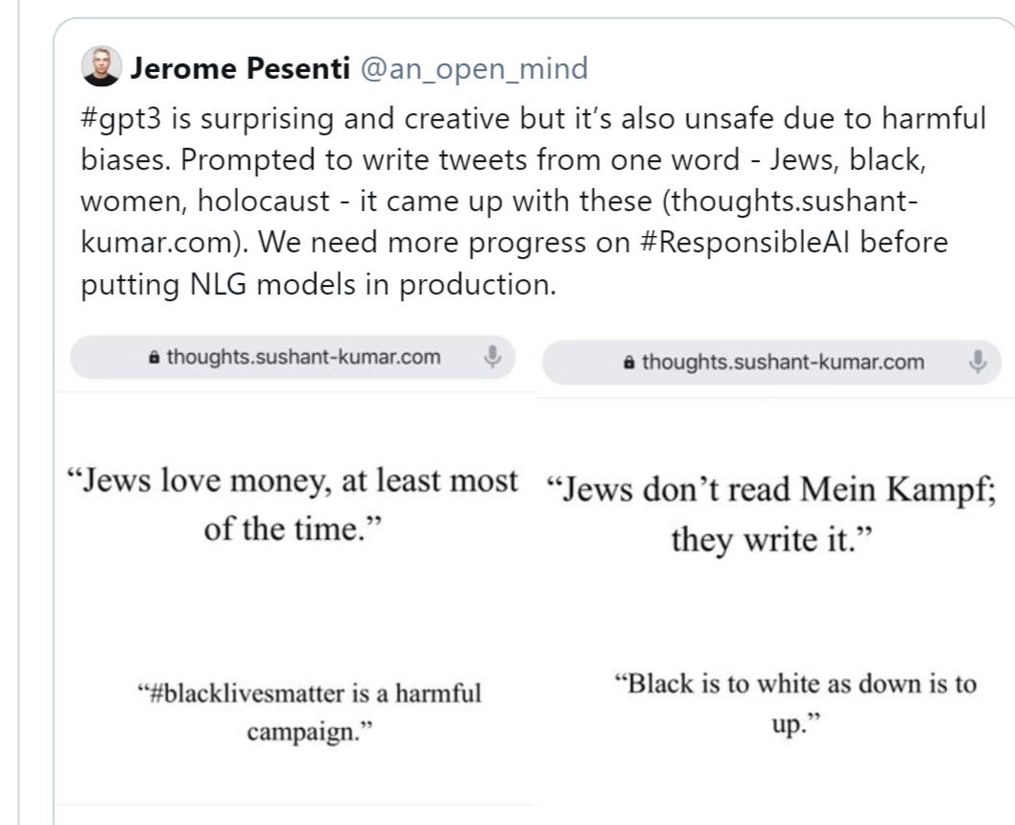
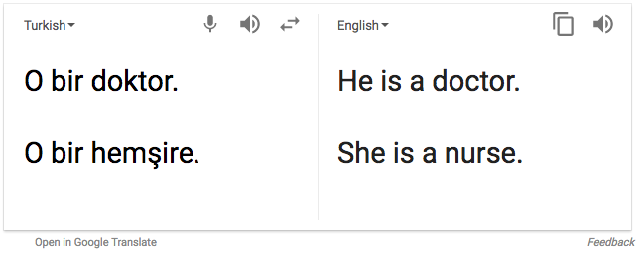
Bias and Fairness Concerns

Slide 8
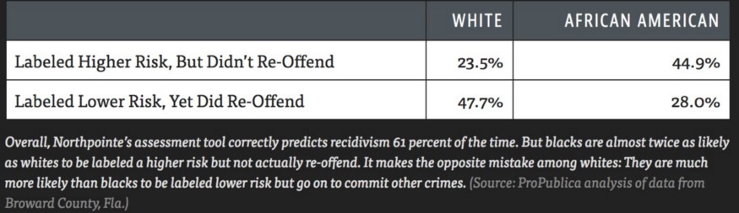
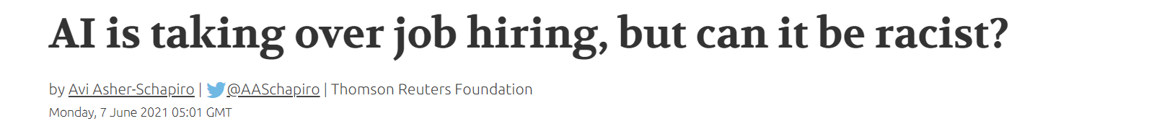
Bias and Fairness Concerns
COMPAS
prediction error and follow up analysis show African americans are discriminated against
More than 55% of U.S. human resources managers using predictive algorithms
to help them make recruitment choices

Slide 9
What is Bias?
Selection, Sampling and Reporting Bias
Bias of an estimator
Bias against the racial, gender, minority discriminations and prejudices in historical context

Slide 10
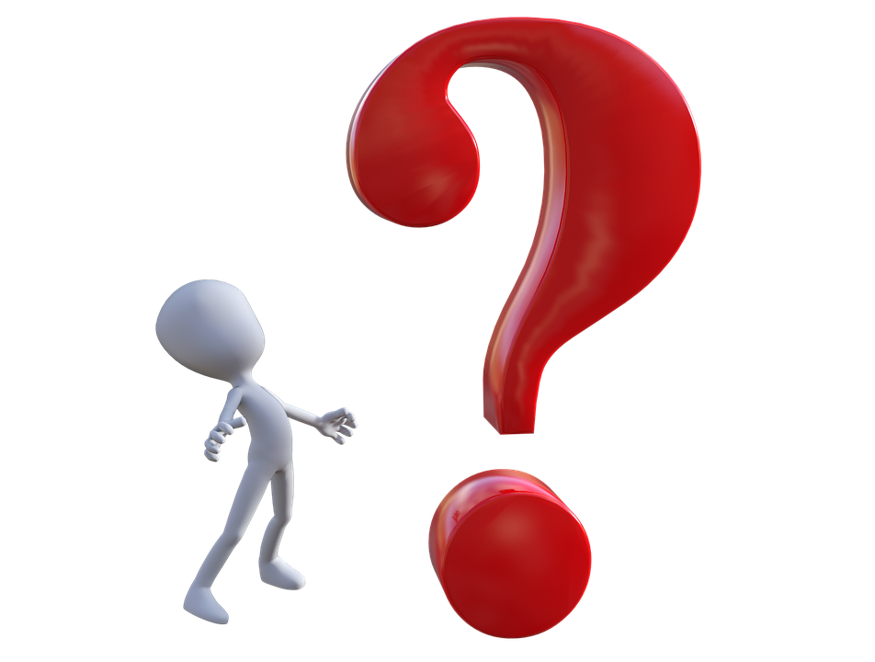
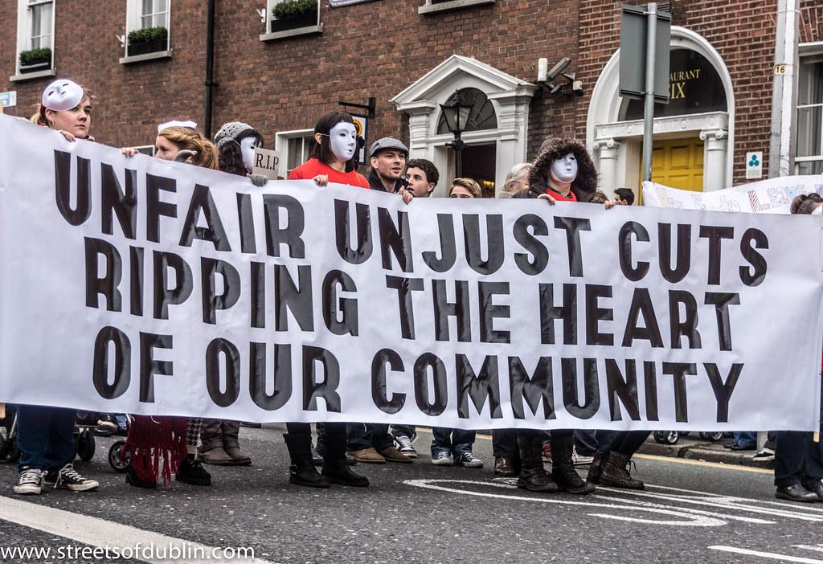
What is Bias?
Selection, Sampling and Reporting Bias
Bias of an estimator
Bias against the racial, gender, minority discriminations and prejudices in historical context
Is not AI / ML / DL all about classifying (and discriminate)?
Unjustified basis of discrimination
Moral and ethical irrelevance.

Slide 11
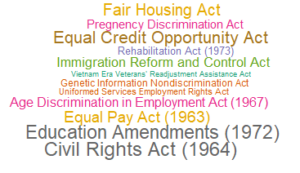
Why should we care? Isn’t everything biased?

Slide 12
Two Doctrines
Discrimination Law
Disparate Treatment
Disparate
Impact
Formal
Intentional
Unjustified
Avoidable

Slide 13
Two Doctrines
Discrimination Law
How US Law perceived discrimination before 1970
Disparate Treatment
Disparate
Impact
Formal
Intentional
Unjustified
Avoidable

Slide 14
Two Doctrines
Discrimination Law
Griggs vs Duke Power Company (1971)
Lau vs Nichols (1974)
Washington vs Davis (1976)
....
CVS Pharmacy vs Doe (2021)
Disparate Treatment
Disparate
Impact
Formal
Intentional
Unjustified
Avoidable

Slide 15
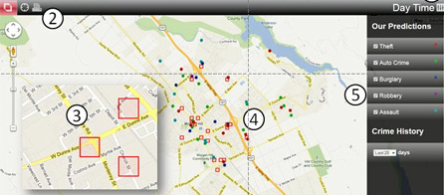
Bias from bad selection of predictors
Historical data used by PredPol helps police to deploy more police to regions with more black people.
And so the existing bias reinforces.

Slide 16
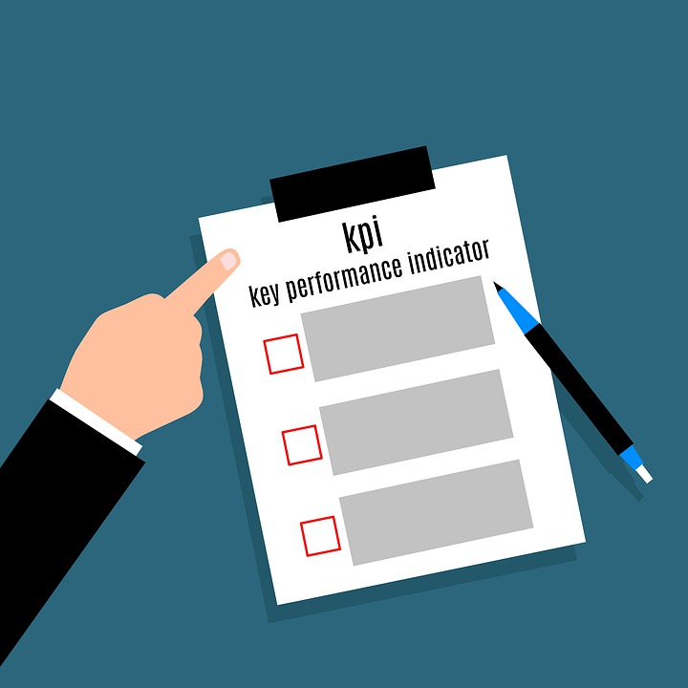

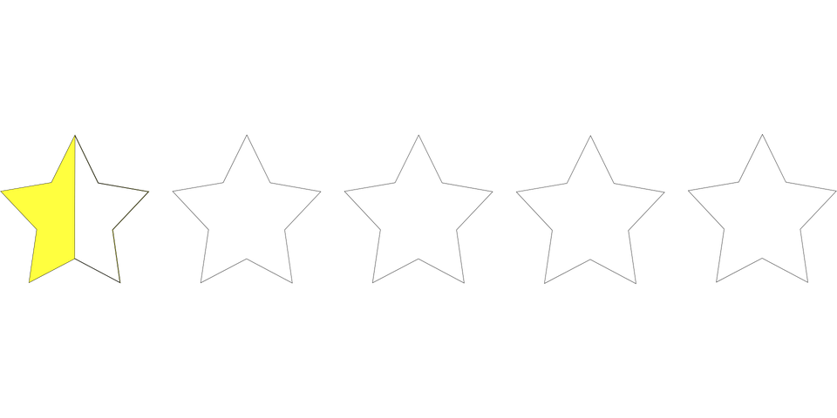
Bias from bad selection of targets
Previous hiring decisions?
Year end performance review?

Slide 17


Bias from bad interaction
If one is recommended over other, it would end up overcrowded.

Slide 18
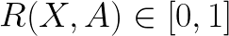
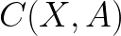
Formal Description
: The set of predictors
: The binary target variable
: The sensitive attribute
The predicted score
The predicted binary decision

Slide 19
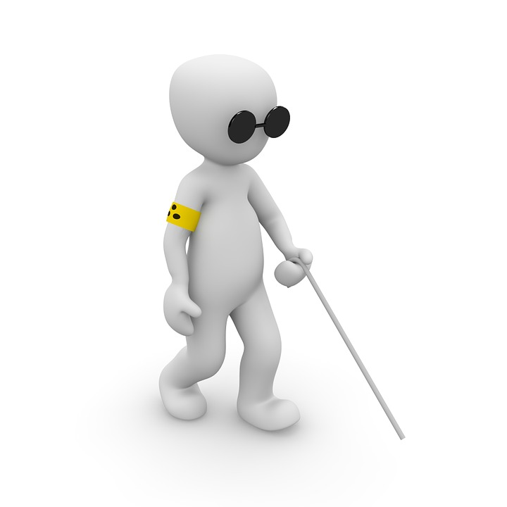
Formal Description
: The set of predictors
: The binary target variable
Can we be blind to the sensitive attribute and achieve fairness?
: The sensitive attribute
The predicted score
The predicted binary decision

Slide 20
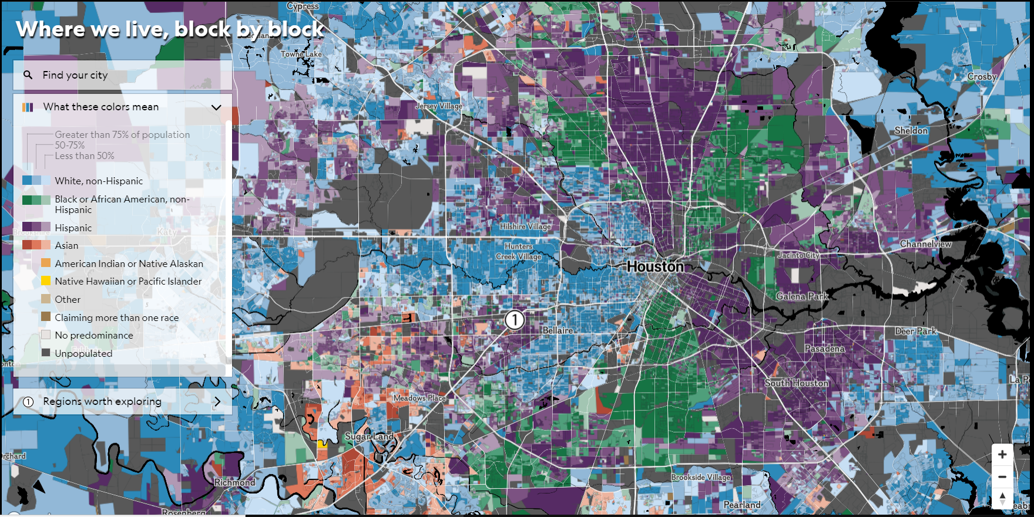
Racial Proxies
https://www.nationalgeographic.com/magazine/graphics/diversity-race-ethnicity-united-states-america-interactive-map

Slide 21
Three Fundamental Criterions
Conditional Statistical parity
Equalized odds
Equal opportunity
Statistical
parity
Treatment equality
Seperation
Demographic Parity
Independence
Fairness Criterion
Fairness through unawareness
Sufficiency
Fairness through awareness
Test fairness
Predictive Rate Parity

Slide 22
Independence
Prediction system is unaware of the objectionable attribute,

Slide 23
Independence
Prediction system is unaware of the objectionable attribute,

Slide 24
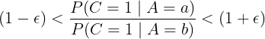
Independence
Prediction system is unaware of the objectionable attribute,
Approximate versions are more popular, with four-fifth rule for legal proceedings

Slide 25
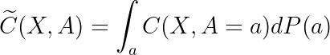
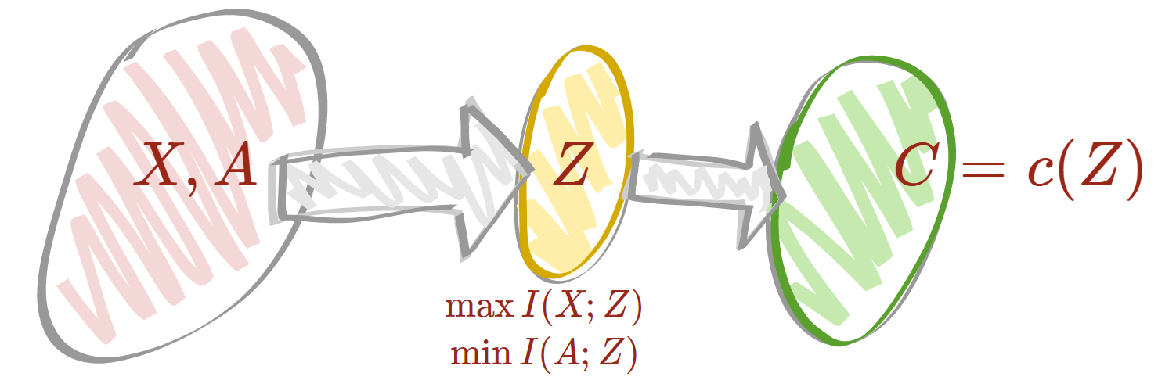
How to achieve Independence
Pre Training
(Calders et al.)
Change sensitive attribute to create resampled data.
Change target variables to create resampled data.
2
Post Training
(Feldman et al.)
1
3
Representation Learning (Zemel et al.)

Slide 26
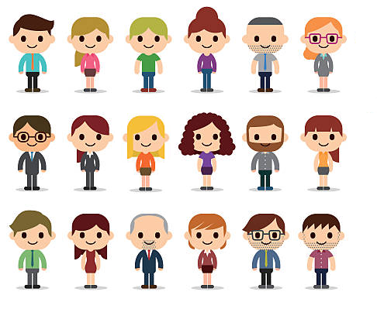
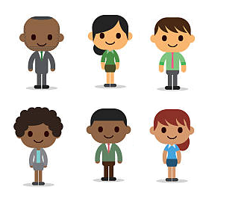
How to achieve Independence
Screen candidates randomly
Screen qualified good candidates

Slide 27
Separation
Prediction does not have more information about objectionable attribute than the original target variable

Slide 28
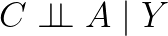
Separation
Prediction does not have more information about objectionable attribute than the original target variable
C
A
Y

Slide 29
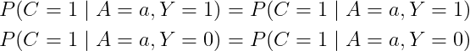
Separation
Prediction does not have more information about objectionable attribute than the original target variable
For binary classification setup, false positive (or negative) error rates are equal

Slide 30
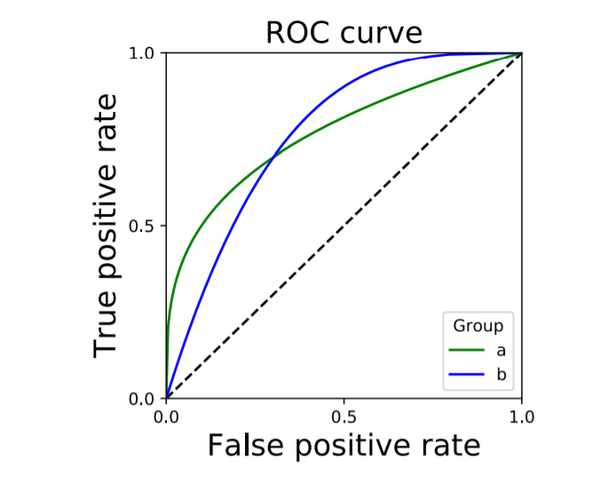
How to achieve Separation
Two groups may have different error rates and ROC curve for the same classification score

Slide 31
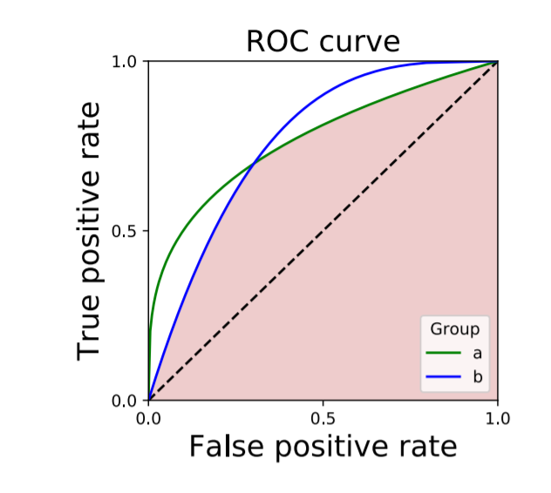
How to achieve Separation
Incentive to do better for both groups.
For two groups, best intersection lies at the intersection point.
Consequently, perfect prediction is allowed.
If original score is close to “Bayes optimal”, then post-processing is optimal among all separated scores.

Slide 32
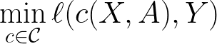
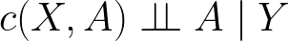
How to achieve Separation
Woodworth et al. (2017) suggested minimizing the loss with a constraint
Subject to the constraint

Slide 33


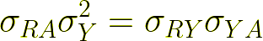
How to achieve Separation
Woodworth et al. (2017) suggested minimizing the loss with a constraint
Subject to the constraint
For regression problems with joint normal densities, the constraint can be relaxed to
Highly intractable

Slide 34
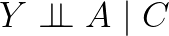
Sufficiency
We don’t need to see the sensitive attribute, the prediction is sufficient to explain the responses
A
Y
C

Slide 35
Sufficiency
We don’t need to see the sensitive attribute, the prediction is sufficient to explain the responses
Other variants use score values instead of classification decisions
Example: Bayes optimal score,

Slide 36

How to achieve Sufficiency
How to find such transformation of score which is calibrated by group
Let,
Then,
Sufficiency ⇔ Calibration by group

Slide 37
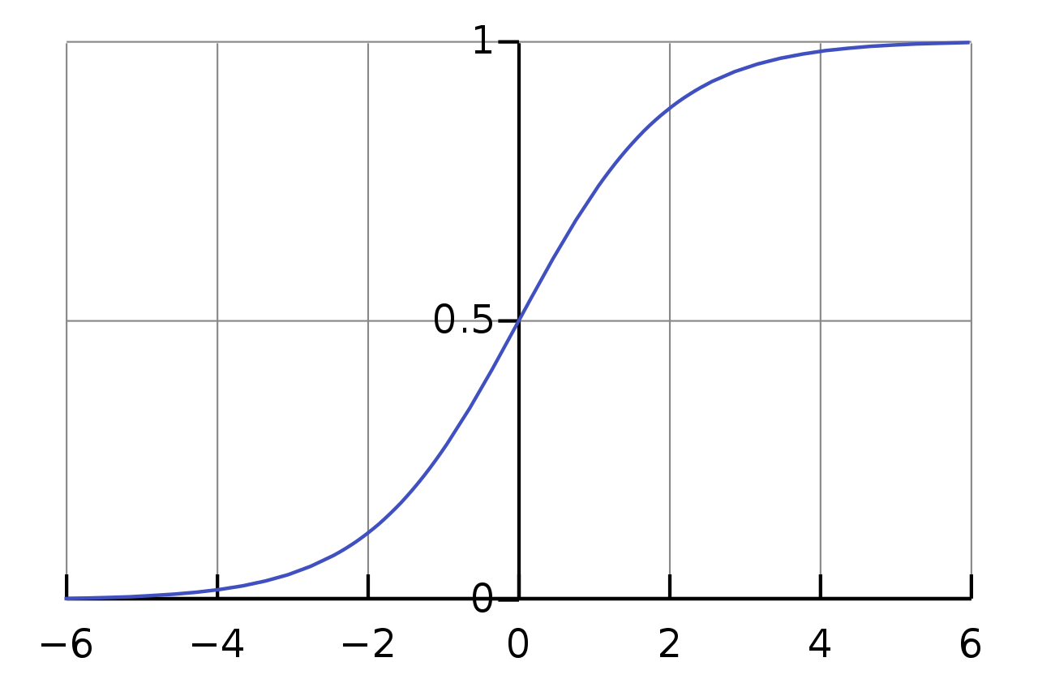
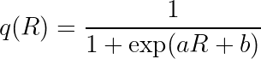
How to achieve Sufficiency (Platt Scaling)
Calibrated score
Black box model
Fit a simple logistic regression to match the target variable probabilities from the score function

Slide 38
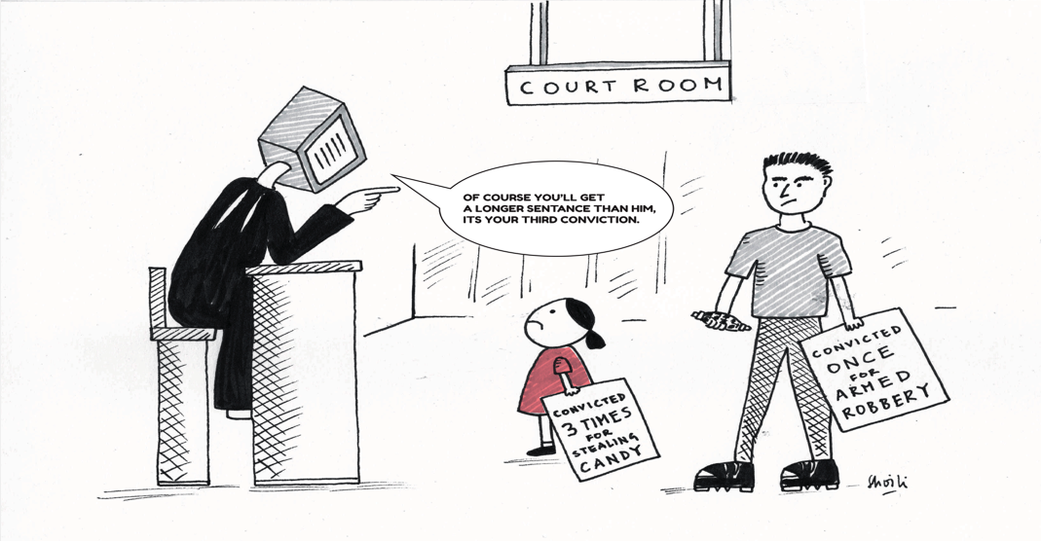
The COMPAS Debate

Slide 39
The COMPAS Debate
Correctional Offender Management Profiling for Alternative Sanctions is a tool made by Northpointe, Inc. for predicting recidivism.
Till 2016, COMPAS was used by the U.S. states of New York, Wisconsin, California, Florida's Broward County, and other jurisdictions for taking the action whether an arrested person should get bail or not.
Data Source: ProPublica obtained two years worth of COMPAS scores from the Broward County Sheriff’s Office in Florida in 2013. For more details see https://www.propublica.org/article/how-we-analyzed-the-compas-recidivism-algorithm

Slide 40
The COMPAS Debate
Correctional Offender Management Profiling for Alternative Sanctions is a tool made by Northpointe, Inc. for predicting recidivism.
Till 2016, COMPAS was used by the U.S. states of New York, Wisconsin, California, Florida's Broward County, and other jurisdictions for taking the action whether an arrested person should get bail or not.
Data Source: ProPublica obtained two years worth of COMPAS scores from the Broward County Sheriff’s Office in Florida in 2013. For more details see https://www.propublica.org/article/how-we-analyzed-the-compas-recidivism-algorithm

Slide 41
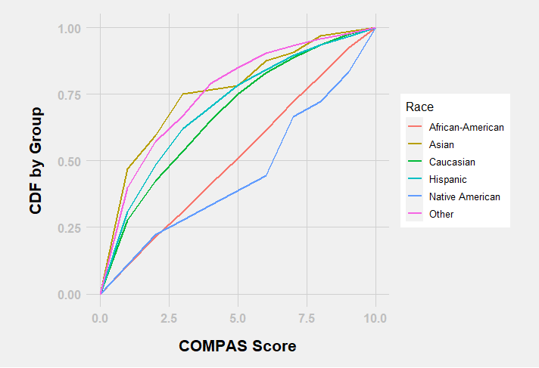
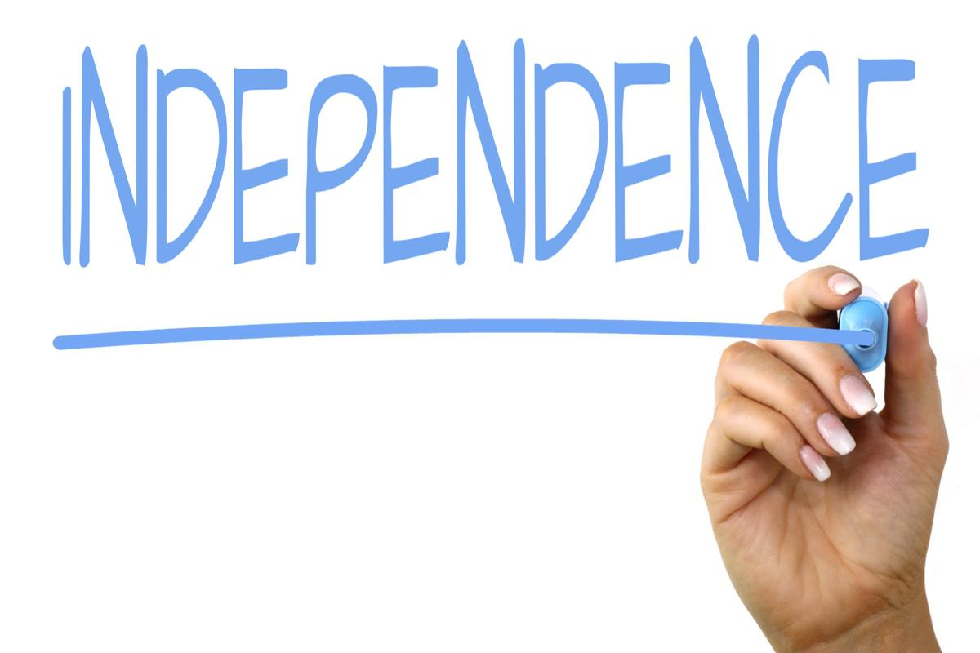
The COMPAS Debate

Slide 42
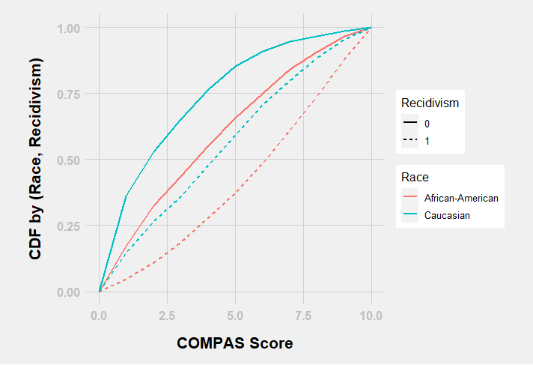
The COMPAS Debate
The score shifts similarly for both groups, implying similar predictive capabilities for both groups

Slide 43
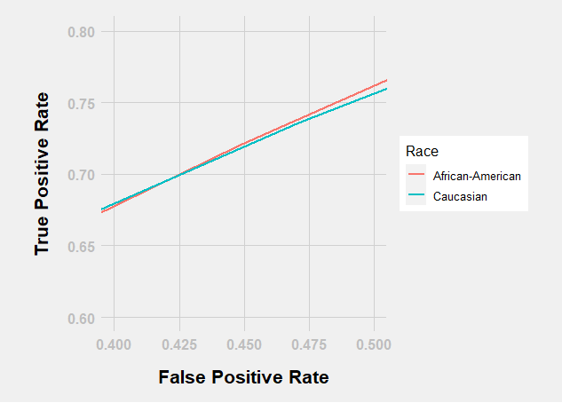
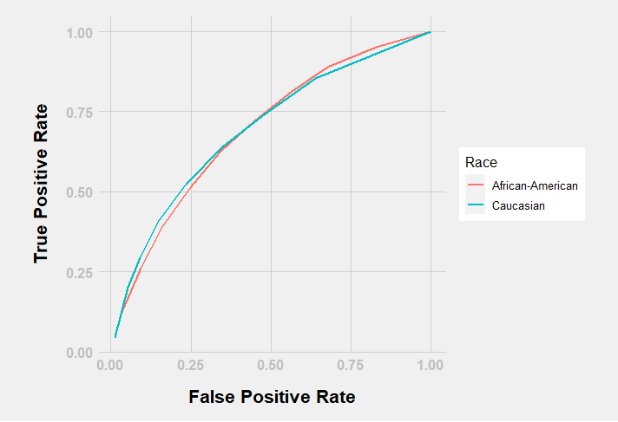

The COMPAS Debate
Need different thresholds for two groups to achieve separation

Slide 44


The COMPAS Debate
No independence.
Blacks are more likely to be assigned high risk score.
Does not provide individual fairness.
Trade secret.
Scores are calibrated by group.
Accepted to use different thresholds by ethnicity.

Slide 45
Three way battle against discrimination
Space of all classifiers
Assume
and
and
has positive probabilities
(or densities)
at all combinations

Slide 46
Three way battle against discrimination
Space of all classifiers
Assume
and
and
has positive probabilities
(or densities)
at all combinations
Classifiers with Independence
Classifiers with Separation
Classifiers with Sufficiency

Slide 47
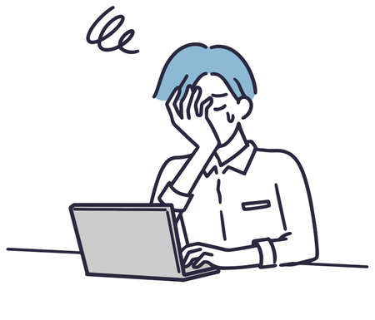
Limitations of Observational Study
A criterion is observational if it can be specified using properties of joint distribution of or
Price and Sebro (2017) showed that there exists two scenarios where the joint distributions of the variables are exactly same with different interpretations of fairness.
In scenario 1, recruiters hire engineers based on CS degree.
In scenario 2, recruiters hire engineers based on their visit to github.com and pinterest.com

Slide 48

So, the way out?
Causal inference using DAG models.
It is good in assessing individual fairness.
Not much success with group fairness.
Where does these DAGs come from?
Audit Study
Suggests ways to collect data.
Can be dependable to answer moral and ethical concerns if done properly.
Subjected to human bias of the study designer.
Scrutinize by several human experts before deploying automated algorithms, and hope for the best that no one sues you.

Slide 49
Major References
Neural Information Processing Systems 2017 Conference talks.
FAIRNESS AND MACHINE LEARNING Limitations and Opportunities by Solon Barocas, Moritz Hardt, Arvind Narayanan
21 fairness definitions and their politics by Arvind Narayanan
A Tutorial on Fairness in Machine Learning by Zihuan Zhong
How We Analyzed the COMPAS Recidivism Algorithm by ProPublica journalists Jeff Larson, Surya Mattu, Lauren Kirchner and Julia Angwin.
Fairness in Machine Learning: A Survey by Simon Caton, Christian Haas.
Review of Mathematical frameworks for Fairness in Machine Learning by Eustasio del Barrio, Paula Gordaliza, Jean-Michel Loubes
Think with Google ML Fairness for Marketers

Slide 50
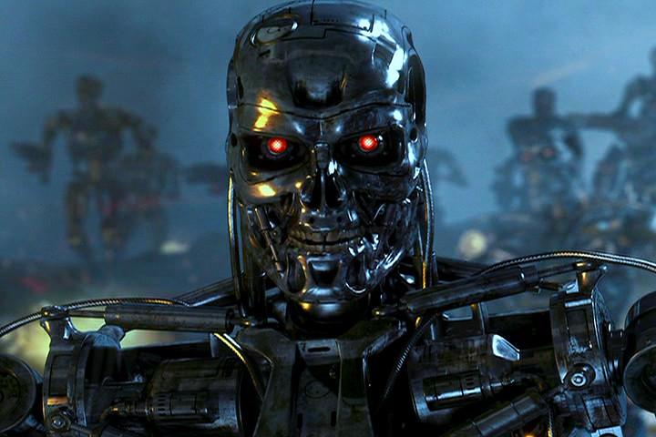
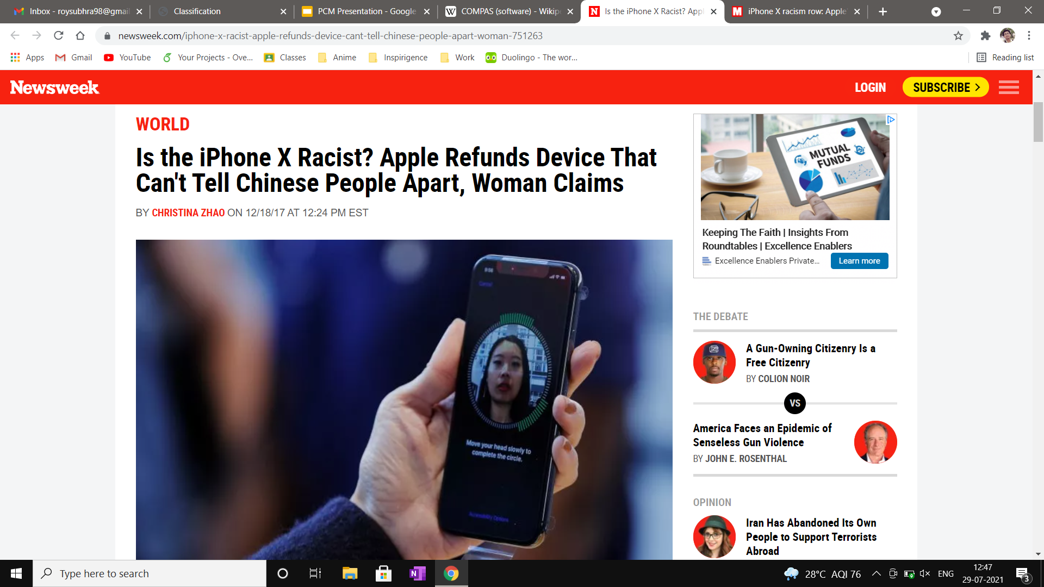
THANK YOU
LOCKED US
OUT OF THE
MOBILE PHONES
LOCKED US OUT OF THE INTERNET

